Slide 1
An adaptive environmental modeling localization method in Wireless Sensor Networks
Professor: Dr. Mohammadali Tinati
Consult Prof: Dr. Mir Javad Mousavi
Judgment Prof: Dr. Behzad Mozaffari
Researcher: Babak Solhjoo

Slide 2
Index: 1
Introduction
Reference Review
Range Based Methods
Range Free Methods
Proposed Algorithm
Model Construction
Simulations
RPLEC
Equation Set
MPLEC
High Errors Removal
Conclusions
Angle Intervals
Subarea
Localization
Future Works
Anchor Density
Node Density
Special Distribution

Slide 3

Introduction: 2
  Wireless Sensor Networks:
    A set of sensors equipped with radio transceiver
  Possibility of using in vast areas
  Possibility of gathering data and sending them to a process center
  Possibility of processing data by nodes individually or in a cooperating groups.
  Destruction of limited number of nodes does not affect the functionality of whole system

Slide 4
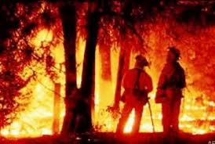
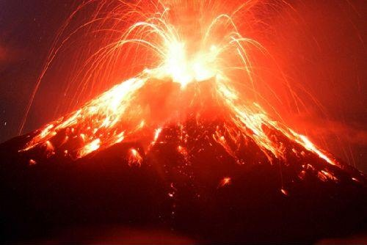
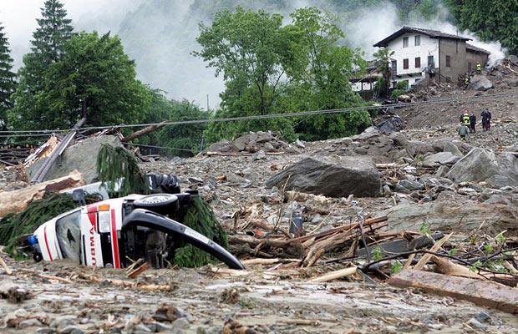
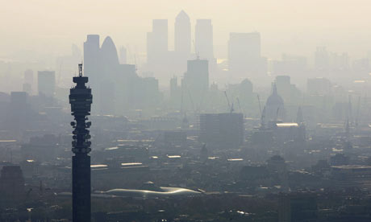
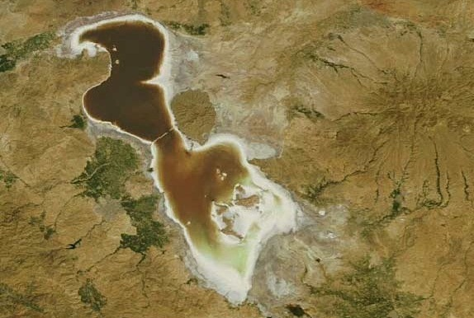
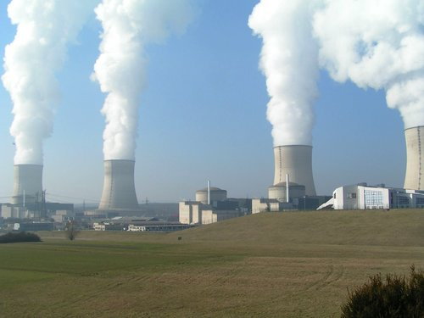
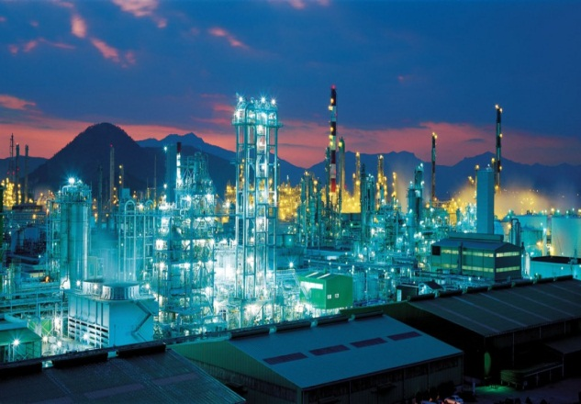
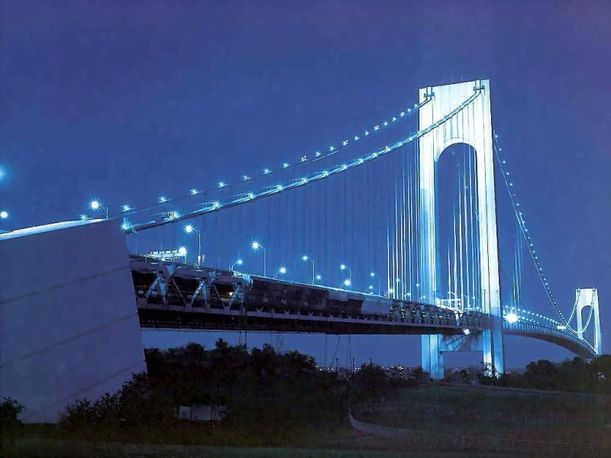
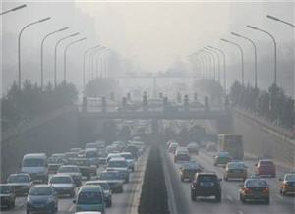
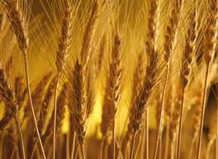

Introduction: 3
Various Applications of Wireless Sensor Networks
  Areas Monitoring
    Frosts Fire
    Eruptions
    Landslide
    Air Pollution
    Natural Disasters
  Industrial Monitoring
    Power plants
    Petrochemical Industries
  Constructs Monitoring
  Monitoring & Control
  Agriculture
  Health

Slide 5

Introduction: 4
  Need of many programs and applications for location info
  Need of Tracking algorithms to localization info
  Having data without correlated location info is not useful
  Localization using anchor nodes
Localization
Range Based
Range Free

Slide 6
Reference Review: 5
Range Free Methods
  These type of methods use the connectivity and signal quality information for localization.
Range Free
Centroid
Dv-Hop:
Distance Vector Hop
APIT:
Approximation Point In triangulation Test

Slide 7
Reference Review: 6
Adaptive Weighted Centroid Method
  Log-Normal Shadow model parameters estimation
  Range estimation from anchor nodes
  Coefficient matrix construction
  Location estimation by weighted centroid
A
d
F
D
d1
E
d3
U
d0
C
d2
B

Slide 8
Reference Review: 7
Range based methods
  These methods uses the range or angle information between the nodes.
Range Based
TOA:
Time Of Arrival
TDOA:
Time Difference Of Arrival
AOA:
Angle Of Arrival
RSSI:
Received Signal Strength

Slide 9
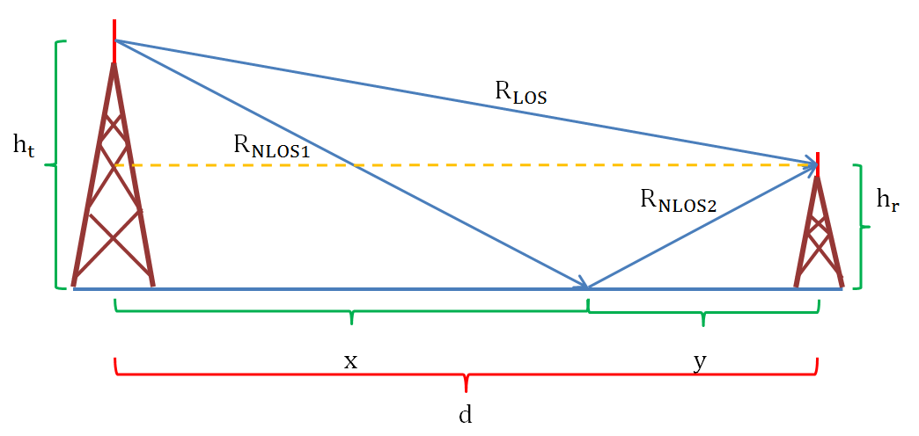
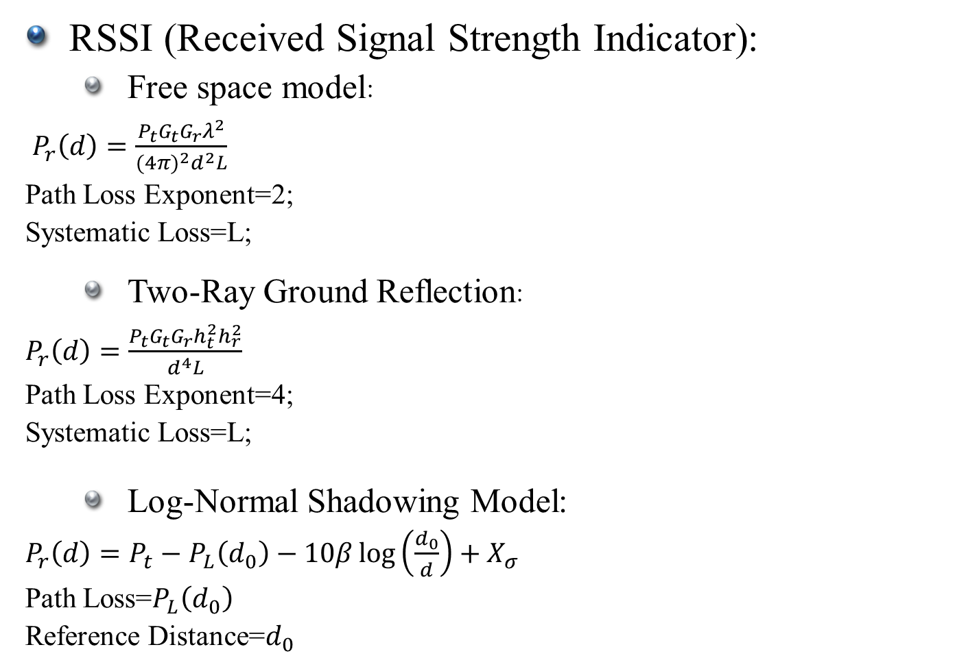
Reference Review: 8
RSSI (Received Signal Strength Indicator):
  Free space model:
  $P_{r}\left(d\right)=\frac{P_{t}G_{t}G_{r}λ^{2}}{{(4π)}^{2}d^{2}L}$
  Path Loss Exponent=2;
  Systematic Loss=L;
  Two-Ray Ground Reflection:
  $P_{r}\left(d\right)=\frac{P_{t}G_{t}G_{r}h_{t}^{2}h_{r}^{2}}{d^{4}L}$
  Path Loss Exponent=4;
  Systematic Loss=L;
  Log-Normal Shadowing Model:
  $P_{r}\left(d\right)=P_{t}−P_{L}\left(d_{0}\right)−10β\log\left(\frac{d_{0}}{d}\right)+X_{σ}$
  Path Loss=$P_{L}\left(d_{0}\right)$
  Reference Distance=$d_{0}$
d

Slide 10
Reference Review: 9
Some algorithms uses specialized methods.
Final Estimation
MMSE
Minimum Mean Square Error
Recursive Cost Function Minimization
LA
Learning Automata

Slide 11
Reference Review: 10
Localization
Range Free
Range Based
TOA
TDOA
AOA
DV-Hop
APIT
Centroid
RSSI
Free Space Model
Two-Ray Ground Model
Log-Normal Shadowing Model
PALA
Model Parameters Averaging
Adaptive Parameter Estimation
Curve Fitting
RF-Map Producing
Neural Networks
LBOA
SVR
Fuzzy Method
Typical Centroid
Weight Centroid
Ellipse Centroid
SA-Centroid
Typical TDOA
Typical TDOA
Typical AOA
RSSI Based AOA
Typical DV-Hop
LDV-Hop
NDV-Hop
RDV-Hop
Typical APIT
RSSI Based APIT
Improved APIT

Slide 12
Reference Review: 11
General Properties of the Localization Methods
Rang-Based
Range Free
Average
No
Low
Yes
TOA
AOA
RSSI
TDOA
High
Yes
Quite High
No
High
Yes
Quite High
No
High
Low
Low
Low
High
Low
High
Yes
High
Sometimes
Average
High
Low
Low
DV-Hop
APIT
Centroid
High
Low
No
Low
Yes
High
High
Very Low
No
Low
Yes
High
Low
High
High
Quite Low
No
No
Yes
Low
Quite Low
Low
Low
Accuracy
Additional Hardware
Cost
Vast Usage
Energy Consumption
Traffic
Simplicity

Slide 13
Reference Review: 12
Desired Factors
Low Cost
High Accuracy
Easy Implementation
Implementation in Large Networks
Low Power Consumption
Robustness against Conditions Change
Scalability
Simple Hardware
Main Problems in RSSI
Robustness against Fluctuations
Circular Range Assumption
Power-Range Accurate Model
Adaptability

Slide 14
Proposed Algorithm: 13
Localization Request
Model Construction
Localization Request from Unknown Node
Data Exchange between the Anchors
Estimation of the Model Parameters for Each Angel Interval
RSSI in Each Anchor
Interpolation
Data Exchange between the Anchors
Data Exchange between the Anchors
Localization
Radius Estimation for Each Anchor by the Chosen Anchor
Solving the Equations and Position Estimation

Slide 15
Proposed Algorithm: 14
Model Construction:
  Data exchange between anchors
Transmitted Power
Transmitter Anchor Node i
Receiver Anchor Node j
Anchor ID
Coordination

Slide 16
Proposed Algorithm: 15
Model Construction:
  Parameter Estimations of the Model:
Information Obtained from the other Anchors
Average PLE (APLE)
Average PLC (APLC)
Anchor Arrangement based on Angle
PLE for Each Angle Interval
PLC for Each Angle Interval

Slide 17





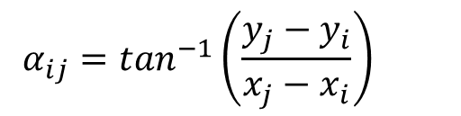

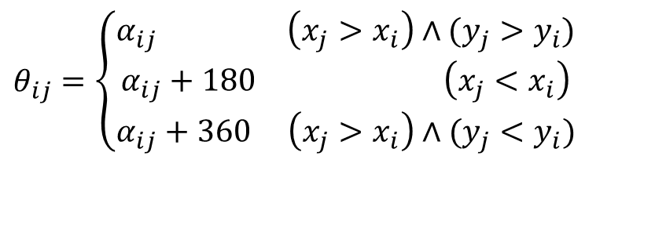


Proposed Algorithm: 16
Estimation of Model Parameters:
  Angle estimation of anchors and their arrangement
$$α_{i3}$$
$$α_{ij}=\tan^{−1}\left(\frac{y_{j}−y_{i}}{x_{j}−x_{i}}\right)$$
$$θ_{i2}$$
$$θ_{i1}$$
$$α_{i1}$$
$$α_{i4}$$
$θ_{ij}=\left\{\begin{aligned}α_{ij} \left(x_{j}>x_{i}\right)∧(y_{j}>y_{i}) \\ α_{ij}+180 \left(x_{j}<x_{i}\right) \\ α_{ij}+360 \left(x_{j}>x_{i}\right)∧(y_{j}<y_{i})\end{aligned}\right.$
$$θ_{i4}$$
$$θ_{i3}$$
$$α_{i2}$$

Slide 18

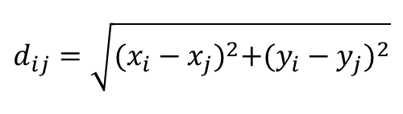
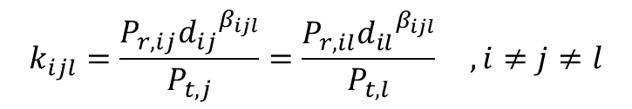
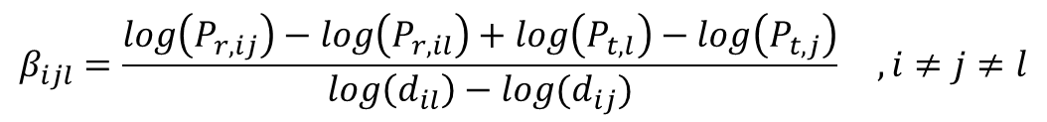
Proposed Algorithm: 17
Estimation of Model Parameters
  Estimating the average PLE and PLC for each anchor
    Equations:
$$P_{r}=\frac{kP_{t}}{{d_{ij}}^{β}}$$
$$d_{ij}=\sqrt{{(x_{i}−x_{j})}^{2}+{(y_{i}−y_{j})}^{2}}$$
$$k_{ijl}=\frac{P_{r,ij}{d_{ij}}^{β_{ijl}}}{P_{t,j}}=\frac{P_{r,il}{d_{il}}^{β_{ijl}}}{P_{t,l}} , i≠j≠l$$
$$β_{ijl}=\frac{\log\left(P_{r,ij}\right)−\log\left(P_{r,il}\right)+\log\left(P_{t,l}\right)−\log\left(P_{t,j}\right)}{\log\left(d_{il}\right)−log⁡(d_{ij})} , i≠j≠l$$

Slide 19
Proposed Algorithm: 18
Estimation of Model Parameters:
  Estimation of Average PLE and PLC for anchors
3
2
4
Receiver Anchor, i
1
j

Slide 20
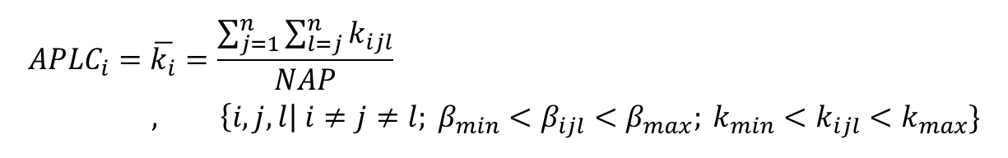
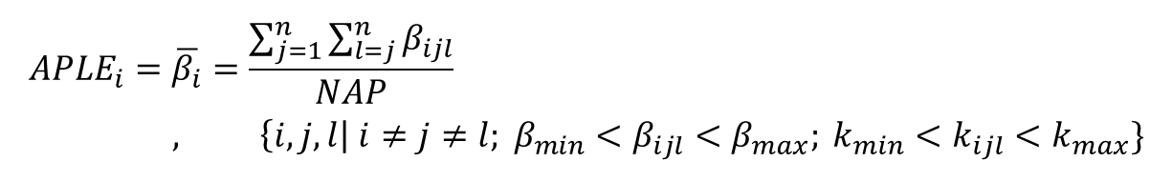
Proposed Algorithm: 19
Estimation of Model Parameters:
  Estimation of Average PLC and PLE for each anchor
    Equations:
$${APLE}_{i}=\overline{β_{i}}=\frac{\sum_{j=1}^{n}{\sum_{l=j}^{n}{β_{ijl}}}}{NAP}, \left\{i,j,l\right| i≠j≠l; β_{min}<β_{ijl}<β_{max}; k_{min}<k_{ijl}<k_{max}\}$$
$${APLC}_{i}=\overline{k_{i}}=\frac{\sum_{j=1}^{n}{\sum_{l=j}^{n}{k_{ijl}}}}{NAP}, \left\{i,j,l\right| i≠j≠l; β_{min}<β_{ijl}<β_{max}; k_{min}<k_{ijl}<k_{max}\}$$

Slide 21

Proposed Algorithm: 20
Estimation of Model Parameters
  Estimating of Average PLE and PLC for each angle interval
$$θ_{r}$$

Slide 22
Proposed Algorithm: 21
Estimating Model Parameters:
Number of Anchor Nodes in Each Angle Interval
More than 2 Anchors
2 Anchors
1 Anchor
No anchor
PLE Calculation
PLC Calculation
Averaging
PLE Calculation
PLC Calculation
Assigning Average PLC and calculating PLE
No Assignment

Slide 23
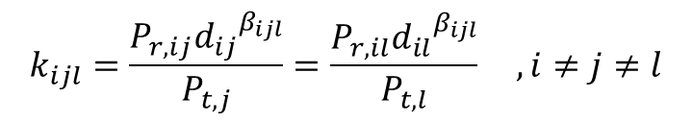
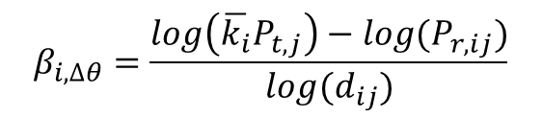
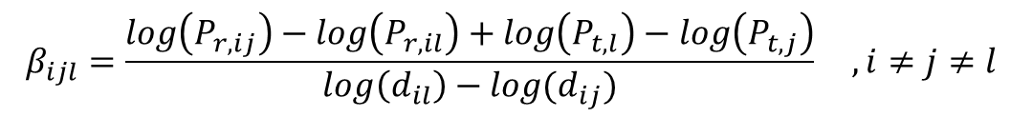
Proposed Algorithm: 22
Estimation of Model Parameters
  One anchor in an angle interval
  Two anchors in an angle interval
  More than two anchor in an angle interval
    Calculation of PLE and PLC for every 2 anchor in an angle interval
$$β_{i,∆θ}=\frac{\log\left(\overline{k_{i}}P_{t,j}\right)−log⁡(P_{r,ij})}{log⁡(d_{ij})}$$
$$k_{ijl}=\frac{P_{r,ij}{d_{ij}}^{β_{ijl}}}{P_{t,j}}=\frac{P_{r,il}{d_{il}}^{β_{ijl}}}{P_{t,l}} , i≠j≠l$$
$$β_{ijl}=\frac{\log\left(P_{r,ij}\right)−\log\left(P_{r,il}\right)+\log\left(P_{t,l}\right)−\log\left(P_{t,j}\right)}{\log\left(d_{il}\right)−log⁡(d_{ij})} , i≠j≠l$$

Slide 24
Proposed Algorithm: 23
Estimation of Model Parameters:
  Check for being in an acceptable range for all values
  Averaging for the case of more than two anchors
  Assignment of values for each angle interval

Slide 25
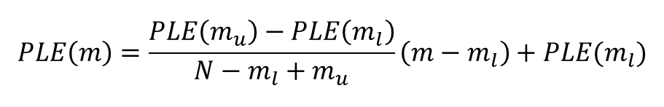
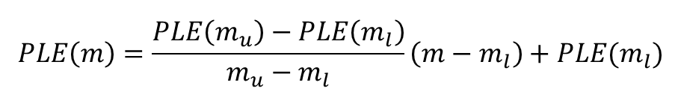
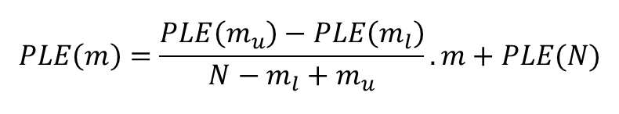
Proposed Algorithm: 24
Interpolation:
1
2
3
4
5
6
7
8
9
10
11
12
13
14
0
180
360
$$PLE\left(m\right)=\frac{PLE\left(m_{u}\right)−PLE\left(m_{l}\right)}{m_{u}−m_{l}}\left(m−m_{l}\right)+PLE(m_{l})$$
$$PLE\left(m\right)=\frac{PLE\left(m_{u}\right)−PLE\left(m_{l}\right)}{N−m_{l}+m_{u}}\left(m−m_{l}\right)+PLE(m_{l})$$
$$PLE\left(m\right)=\frac{PLE\left(m_{u}\right)−PLE\left(m_{l}\right)}{N−m_{l}+m_{u}}.m+PLE(N)$$

Slide 26
Proposed Algorithm: 25
Data exchange between anchors:
Model Exchange between anchors mentioning ID
Traffic Reduction on the Network
Energy Consumption Reduction
Necessary Data for equation sets construction

Slide 27
Proposed Algorithm: 26
Localization Request:
Unknown Node
Transmission of Localization Request
Transmitted Power
Unknown Node ID
Measurement of received power
Anchor Node

Slide 28





Proposed Algorithm: 27
Data Exchange between Anchors:
$$A_{3}$$
$$A_{i}$$
$$A_{2}$$
U
$$A_{1}$$
$$A_{1}$$

Slide 29
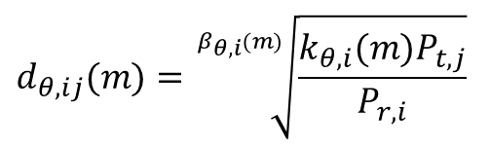
Proposed Algorithm: 28
Range estimation for each anchor:
Received Power
Transmitted Power
Estimated Model
Estimated Ranges for each Range Interval
$$d_{θ,ij}(m)=\sqrt[β_{θ,i}(m)]{\frac{k_{θ,i}(m)P_{t,j}}{P_{r,i}}}$$

Slide 30
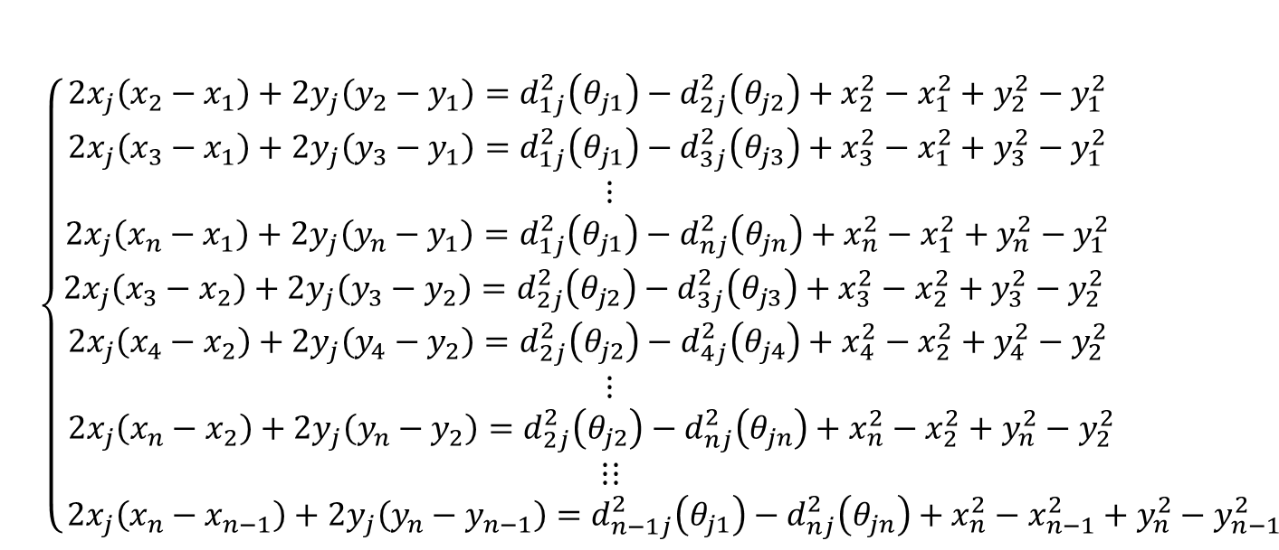

Proposed Algorithm: 29
Equations set and solution:
$\left\{\begin{aligned}{(x_{j}−x_{1})}^{2}+{(y_{j}−y_{1})}^{2}=d_{1j}^{2}\left(θ_{j1}\right) \\ {(x_{j}−x_{2})}^{2}+{(y_{j}−y_{2})}^{2}=d_{2j}^{2}\left(θ_{j2}\right) \\ ⋮ \\ {(x_{j}−x_{n})}^{2}+{(y_{j}−y_{n})}^{2}=d_{1j}^{2}\left(θ_{jn}\right)\end{aligned}\right.$
$\left\{\begin{aligned}2x_{j}\left(x_{2}−x_{1}\right)+2y_{j}\left(y_{2}−y_{1}\right)=d_{1j}^{2}\left(θ_{j1}\right)−d_{2j}^{2}\left(θ_{j2}\right)+x_{2}^{2}−x_{1}^{2}+y_{2}^{2}−y_{1}^{2} \\ 2x_{j}\left(x_{3}−x_{1}\right)+2y_{j}\left(y_{3}−y_{1}\right)=d_{1j}^{2}\left(θ_{j1}\right)−d_{3j}^{2}\left(θ_{j3}\right)+x_{3}^{2}−x_{1}^{2}+y_{3}^{2}−y_{1}^{2} \\ ⋮ \\ 2x_{j}\left(x_{n}−x_{1}\right)+2y_{j}\left(y_{n}−y_{1}\right)=d_{1j}^{2}\left(θ_{j1}\right)−d_{nj}^{2}\left(θ_{jn}\right)+x_{n}^{2}−x_{1}^{2}+y_{n}^{2}−y_{1}^{2} \\ 2x_{j}\left(x_{3}−x_{2}\right)+2y_{j}\left(y_{3}−y_{2}\right)=d_{2j}^{2}\left(θ_{j2}\right)−d_{3j}^{2}\left(θ_{j3}\right)+x_{3}^{2}−x_{2}^{2}+y_{3}^{2}−y_{2}^{2} \\ 2x_{j}\left(x_{4}−x_{2}\right)+2y_{j}\left(y_{4}−y_{2}\right)=d_{2j}^{2}\left(θ_{j2}\right)−d_{4j}^{2}\left(θ_{j4}\right)+x_{4}^{2}−x_{2}^{2}+y_{4}^{2}−y_{2}^{2} \\ ⋮ \\ 2x_{j}\left(x_{n}−x_{2}\right)+2y_{j}\left(y_{n}−y_{2}\right)=d_{2j}^{2}\left(θ_{j2}\right)−d_{nj}^{2}\left(θ_{jn}\right)+x_{n}^{2}−x_{2}^{2}+y_{n}^{2}−y_{2}^{2} \\ ⋮⋮ \\ 2x_{j}\left(x_{n}−x_{n−1}\right)+2y_{j}\left(y_{n}−y_{n−1}\right)=d_{n−1j}^{2}\left(θ_{j1}\right)−d_{nj}^{2}\left(θ_{jn}\right)+x_{n}^{2}−x_{n−1}^{2}+y_{n}^{2}−y_{n−1}^{2} \end{aligned}\right.$

Slide 31

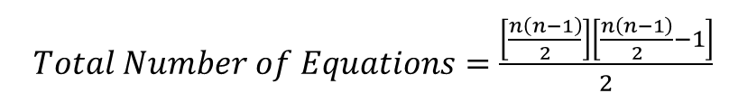



Proposed Algorithm: 30
Number of equations to be solved:
Construction and solution of equations:
Total Number of Equations in Network:
$$NE=\frac{n(n−1)}{2}$$
$$\left[\begin{aligned}\begin{matrix}\left(x_{l}−x_{i}\right) & \left(y_{l}−y_{i}\right)\end{matrix} \\ \begin{matrix}\left(x_{p}−x_{q}\right) & \left(y_{p}−y_{q}\right)\end{matrix}\end{aligned}\right]\left[\begin{aligned}x_{j} \\ y_{j}\end{aligned}\right]=0.5×\left[\begin{aligned}d_{ij}^{2}\left(θ_{ji}\right)−d_{lj}^{2}\left(θ_{jl}\right)+x_{l}^{2}−x_{i}^{2}+y_{l}^{2}−y_{i}^{2} \\ d_{qj}^{2}\left(θ_{jq}\right)−d_{pj}^{2}\left(θ_{jp}\right)+x_{p}^{2}−x_{q}^{2}+y_{p}^{2}−y_{q}^{2}\end{aligned}\right]$$
$1<j,k,l,m≤n ; j>k≥1 ;l>m≥1$
$$AX=D(θ)$$
$$X=A^{−1}D(θ)$$
$Total Number of Equations=\frac{\left[\frac{n\left(n−1\right)}{2}\right]\left[\frac{n\left(n−1\right)}{2}−1\right]}{2}$

Slide 32



Proposed Algorithm: 31
Geometrical representation of equations results:
$$B$$
$$A$$
$$C$$

Slide 33

Proposed Algorithm: 32
Choose a Joint Equation, Reset Tr
Start
Random Point, Reset LP
Final Estimation
Yes
No
LP>MaxLP
Angle Calculation
Equation Remains
Yes
Distance Calculation
LP=LP+1
Yes
No
Tr>MaxTr
No
Yes
Error>Max
Solving the Equations, New Point
Tr=Tr+1
No
Yes
Error<Min
Save if the Point is Approved
Error=|NewPoint-OldPoint|

Slide 34













Proposed Algorithm: 33
Error Sources:
$$d_{es2}$$
$$B$$
$$B$$
$$A$$
$$d_{Ac2}$$
$$C$$
$$d_{es3}$$
$$A$$
$$d_{Ac1}$$
$$d_{Ac3}$$
$$d_{es1}$$
$$C$$
$$Est. Point$$

Slide 35














Proposed Algorithm: 34
Elimination of high error points:
  Distance of the confirmed points should be less than the distance calculated in the model:
$$A$$
$$r_{eA}$$
$$r_{eB}$$
$$B$$
$$d_{eC}$$
$$r_{e′C}$$
$$r_{e′A}$$
$$d_{eA}$$
$$C$$
$$d_{eB}$$
$$r_{e′B}$$
$$r_{e′C}$$
$$d_{e′A}$$
$$d_{e′B}$$
$$d_{e′C}$$

Slide 36


















Proposed Algorithm: 35
Final Estimation:
$$x_{FE}=\frac{\sum_{i=1}^{z}{x_{AP,i}}}{z}$$
$$y_{FE}=\frac{\sum_{i=1}^{z}{x_{AP,i}}}{z}$$
$${AP}_{1}$$
$${AP}_{z}$$
$${AP}_{7}$$
$$ε_{1}$$
$${AP}_{2}$$
$$ε_{7}$$
$$ε_{z}$$
$$FE$$
$$ε_{2}$$
$${AP}_{6}$$
$$ε_{6}$$
$$ε_{3}$$
$$ε_{5}$$
$$ε_{4}$$
$${AP}_{3}$$
$${AP}_{5}$$
$${AP}_{3}$$

Slide 37





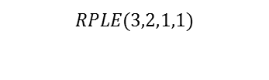
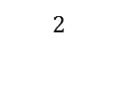



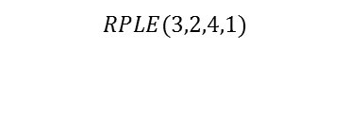

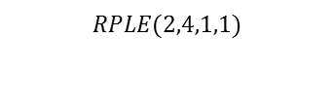
Proposed Algorithm: 36
Type of fluctuations
  Regional Fluctuations (Long distance-High value Fluctuations)
  Common Region Fluctuations (Small Distance-Small value Fluctuations)
$$1$$
$$2$$
$$3$$
$$4$$
$$5$$
$$1$$
$$RPLE(2,4,1,1)$$
$$2$$
$$RPLE(3,2,1,1)$$
$$3$$
$$RPLE(3,2,2,4)$$
$$4$$
$$RPLE(3,2,4,1)$$

Slide 38
Proposed Algorithm: 37
Setting Simulation Parameters
  Close areas should have close properties
  Definition of some parameters
$$RPLER=\frac{Maximum Amplitude of the Regional Variations of the PLE}{Average value of PLE}$$
$$RPLCR=\frac{Maximum Amplitude of the Regional Variations of the PLC}{Average value of PLC}$$
$$MPLER=\frac{Maximum Amplitude of the Minor Variations of the PLE}{Maximum Amplitude of the Regional Variations of the PLE}$$
$$MPLCR=\frac{Maximum Amplitude of the Minor Variations of the PLC}{Maximum Amplitude of the Regional Variations of the PLC}$$

Slide 39
Proposed Algorithm: 38
TPLE parameter across the region:

Slide 40
Proposed Algorithm: 39
TPLC parameter across the region:

Slide 41
Simulation Results: 40
Sample of calculated PLE
Sample of calculated PLC
Sample of calculated Range
Sample of calculated PLE
Sample of calculated PLC
Sample of calculated Range

Slide 42
Simulation Results: 41
Solving recursive equations:

Slide 43
Simulation Results: 42
Solving recursive equations:

Slide 44
Simulation Results: 43
Solving recursive equations:

Slide 45
Simulation Results: 44
Behavior of algorithm in uniform distributions:

Slide 46
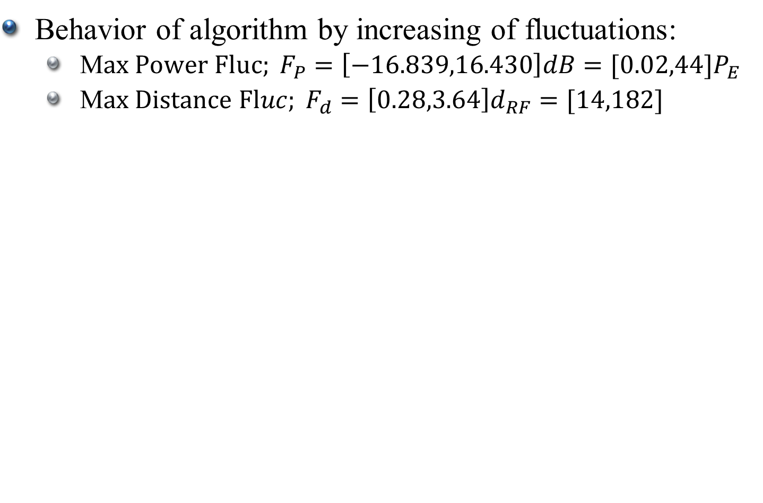
Simulation Results: 45
Behavior of algorithm by increasing of fluctuations:
  M$ax Power Fluc; F_{P}=\left[−16.839,16.430\right]dB=[0.02,44]P_{E}$
  M$ax Distance Fluc; F_{d}=\left[0.28,3.64\right]d_{RF}=[14,182]$

Slide 47
Simulation Results: 46
Behavior of algorithm by increase of fluctuations:

Slide 48

Simulation Results: 47
Behavior of algorithm by increasing minor scale Flucs.
  M$ax Power Fluc; F_{P}=\left[−11.16,11\right]dB=\left[0.076,12.54\right]P_{E}$
  Max Distance Fluc; $F_{d}=\left[0.43,2.35\right]d_{RF}=[21.5,117.5]$

Slide 49
Simulation Results: 48
Behavior of algorithm by increasing minor scale Flucs.

Slide 50
Simulation Results: 49
Algorithm behavior by Angle Interval Number increase

Slide 51
Simulation Results: 50
Algorithm behavior by Angle Interval Number increase

Slide 52
Simulation Results: 51
Algorithm behavior by sub-areas number increase

Slide 53
Simulation Results: 52
Algorithm behavior by sub-areas number increase

Slide 54
Simulation Results: 53
Algorithm behavior by increase of anchor nodes

Slide 55
Simulation Results: 54
Algorithm behavior by increase of anchor nodes

Slide 56
Simulation Results: 55
Algorithm behavior by increasing the node density

Slide 57
Simulation Results: 56
Algorithm behavior by increasing the node density

Slide 58
Simulation Results: 57
Algorithm behavior by changing the range coeff for high error points elimination

Slide 59
Simulation Results: 58
Algorithm behavior by changing the range coeff for high error points elimination

Slide 60
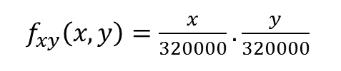
Simulation Results: 59
Algorithm behavior in non-uniform distributions
$f_{xy}\left(x,y\right)=\frac{x}{320000}.\frac{y}{320000}$

Slide 61
Simulation Results: 60
Algorithm behavior by increase of fluctuations

Slide 62
Simulation Results: 61
Algorithm behavior by increase of fluctuations

Slide 63
Simulation Results: 62
Algorithm behavior in special anchor distribution

Slide 64
Simulation Results: 63
Algorithm behavior in special anchor distribution

Slide 65
Simulation Results: 40
Poor localization in special anchor distribution

Slide 66
Conclusions: 65
Non-Circular Model
AEM
Few Samples
Adaptability
Lesser Localization Error
More Localized Nodes
Better Performance in the Low Node Densities

Slide 67
Conclusions: 66
Localization Error
Coverage
Traditional RSSI
Adaptive Centroid
AEM
AEM
Adaptive Centroid
Traditional RSSI
+
+
+
Regional Fluctuations
+
+
+
+
+
+
Minor Fluctuations
-
+
-
+
+
+
Number of Subareas
+/-
+
+/-
=
=
-
Angle Resolution
+
=
=
-
-
-
Anchor Density
+
+
+
=
=
=
Node Density
=
=
=

Slide 68
Conclusions: 67
Future Works
Interpolation Methods
2D Models
Expanding to 3D Localization
Using TOA or TDOA with non-circular models
Enhancing the coverage for low densities
Polynomial interpolation
ANN
Using 2D Models
Exponential interpolation
Fuzzy
Using 3D models
LPF-Interpolation
Traditional models
Other interpolations

Slide 69
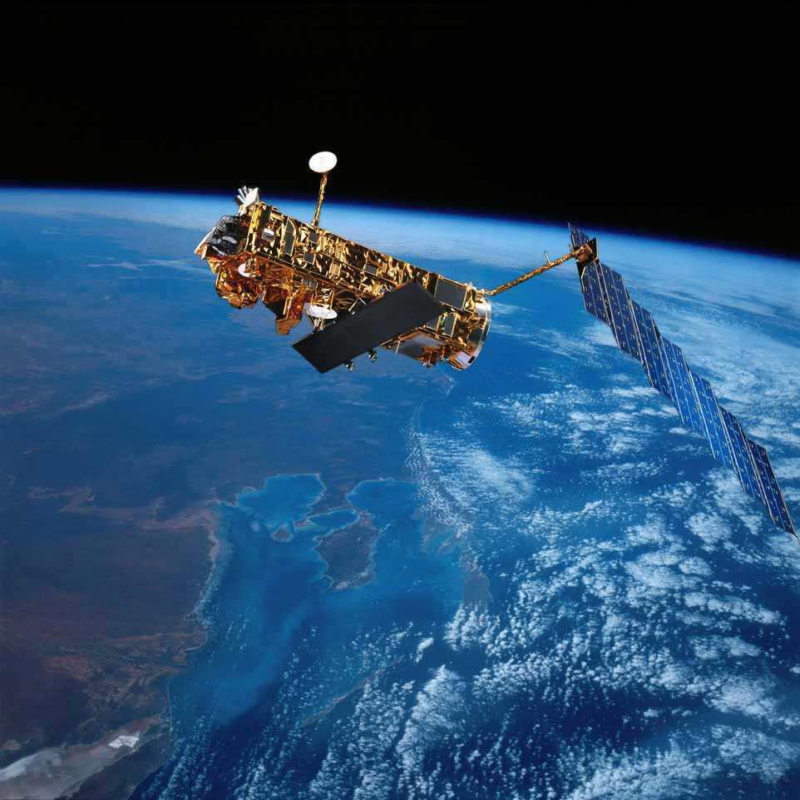
Thanks for your attention.
Any question?

